Slide 1

Innovation Centre
Delivering smarter IT solutions for your business

Slide 2
PREDICTIVE Incident MANAGEMENT
BUSINESS CHALLENGES
Handling large number of ITSM tickets [Volume affects the ticket routing, prioritizing and resolution]
High volume of incidents results in increased MTTR, risking SLA compliance and customer satisfaction
How to proactively prevent or minizine a service outage?
How to predict an impact of an incident?
How to mitigate the risks of change-related incidents?
How to Predict incidents on environmental change?
SOLUTION
Utilising the Machine Learning algorithms, data analysis methods to create a solution that is capable of
Incident type identification
Resolution time prediction
Predicting a potential problem on a new change (change risk prediction)
Predicting incidents on environmental change
Predicting possibility of a change failure
Root Cause Analysis
Notes:
Challenges :
Filter/ remove confidential (PII) data [ Data cleansing]
As part of analysis , we identified that only two column (description & impact) are useful for further processing.
Extracting the pattern from unstructured description.
Defined incident Types were not present in the data, hence it need to be identified ,hence unsupervised approach is used.
The textual data can not be used for clustering or model training , hence conversion to numerical format is required.
For identifying the different incident types present in the data ( hidden) , we used clustering technique.
For predicting the incident type from available description of ticket, various ML libraires were used identify the right approach i.e. if mean accuracy scores were used for selection of best ML model.

Slide 3
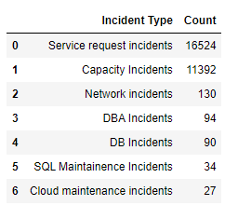
PREDICTIVE Incident MANAGEMENT
BENEFITS
Faster MTTR (Mean Time To Resolution) : Automatic Ticket routing based on incident types; root cause analysis will help to improve MTTR
This will be acting as a catalyst between operations and the ticketing management system. It will help you to organize your incident management in a better way.
Increased Productivity : The models will also help to find the root cause of incidents, so the amount of time spent by the L1,L2 team will drastically reduced , they can be utilized for other things
Reactive to Proactive Approach : Incident prediction on change request failure, or environment change will help to fix the issues before it become system wide incidents.
It will help you to make better business decisions. Then you can take a call on which area to focus on.

Slide 4
PROCESS FLOW
Start
Create new data variable using data pre-processing
Identify if incident is related to
Change request or
Environment Change or
Other
Cluster the incidents to identify the pattern
Incidents related to Change request
Incidents related to Environment change
Model training & evaluation for predication of incidents categories
on Change Request
on Environment Change
Predication of other incidents using NLP techniques
Prediction of resolution time
Predicting possibility of a change failure
Predict the components related new change
Predicting possible incident on a new deployment
Root Cause Analysis
Data Analysis
Data Collection
Documentation
18/07/22
25/07/22
27/07/22
29/07/22
03/08/22
Step - 1
Step - 2
Step - 3
Step - 4
Step - 5
11/08/22
11/08/22
09/08/22
Step - 10
Step - 9
Step - 8
Step - 7
Step - 6
Step - 11
Step - 12
Step - 13
Step - 14
Notes:
Step 1 : Start
Step 2 : Data Collection :
Dataset is from ServiceNow platform.
Dataset has 28,000 real world records from January to March 22.
Step 3 . Data Analysis :
Data analysis involves inspection of all columns in data, its data type, values and selecting the column for further processing.
After data analysis, we found that out of 21 columns, only 2 columns can be used for processing .They are Description & Impact
For Data Analysis following python libraries are used :
pandas (For handling the dataframes)
numpy (for handling the arrays)
re (for identifying the pattern using regex)
Step 4. Create new data variable using data pre-processing :
After data analysis Description & Impact are selected, Impact is categorical variable with values as High , Medium & Low.
Description field gives the information about reported ticket. The description column have both structured & unstructured text data. Handling it is challenging.
Pre-processing steps are applied so as to get clean-short description
Following python libraries are used :
pandas (For handling the dataframes) , numpy (for handling the arrays) , re (for identifying the pattern using regex)
Step 5 :Identify if incident is related to Change request or Environment Change or Other :
The ticket is identified , if it is related to any change request or Environment Change
For this processed description is used. Two different set of keyword is used to identify if ticket is related change request or Environment change
Following python libraries are used :
pandas (For handling the dataframes containing the description)
Step 6 : Cluster the incidents to identify the pattern :
Data set contains different incidents, similar incidents needs to grouped together, so that We can use these incident types for model training & prediction.
For grouping of incidents , k-means clustering algorithm is used.
The grouping of incidents is done using processed text description.
Following python libraries are used :
pandas, matplotlib (for Visualization) , TfidfVectorizer (for creating TF-IDF vectors from text) , Kmeans (for clustering algorithm), PCA (for reducing the number of features to two, so that clusters can be shown on plots)
Step 7 : Model training & evaluation for predication of incidents categories :
Every change request or Environment change related ticket is need to be categorized in any one of the incident type, based on its description.
For this purpose , we need to create two classifiers. One for change request related and other for Environment related tickets.
For each classifier , we trained ,4-5 different classifiers, all are tested 5-fold cross validation and selected one classifier with best mean accuracy value.
Following python libraries are used :
CountVectorizer (to convert text to array of token counts)
LinearSVC ,DecisionTreeClassifier,RandomForestClassifier,KNeighborsClassifier , MultinomialNB (These are used for creating classifiers)
train_test_split (for splitting the data), accuracy_score, classification_report (for performance evaluation)
Joblib (for saving & loading trained models)
Step 8 : Predication of other incidents using NLP techniques :
For all other tickets which are not related to any change request or Environment Change , are analyzed
Most of these are Capacity Incidents or Service request Incidents.
We used the processed description & set of keywords to identify if ticket is capacity incident or Service request Incidents
Following python libraries are used :
pandas (For handling the dataframes containing the description)
Step 9 : Prediction of resolution time :
When a ticket is created in system, this step will predict the expected average resolution time .
For this , first the incident type of ticket will be identified, then its sub-category of ticket is identified, using this information and with analysis of similar past tickets, its expected resolution time will be calculated.
Step 10 : Predicting possibility of a change failure
When a change request is raised, then what is possibility of change failure
Step 11 : Predict the components related new change
When a new change is applied, what components may fail
Step 12 : Predicting possible incident on a new deployment
Step 13 : Root Cause Analysis
Step 14 : Documentation

Slide 5
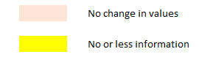
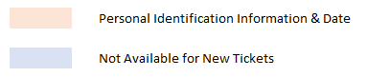
RAW Data
Sr. No | Fields | Type | Details
1 | Number | String | Alpha Numeric
2 | Updated | Date | Date & Time
3 | Active | String | Category
4 | Assigned to | String | User Name
5 | Assignment group | String | Category
6 | Business duration | Int | Number
7 | Affected User | String | User Name
8 | Closed | Date | Date & Time
9 | Closed By | String | User Name
10 | Created | Date | Date & Time
11 | Created by | String | User Name
12 | Description | String
13 | Domain | String | Category
14 | Duration | Int | Number
15 | Impact | String | Category
16 | Incident Type | String | Category
17 | Incident state | String | Category
18 | Made SLA | String | Category
19 | Requester | String | User Name
20 | Resolve time | Date | Date & Time
21 | State | String | Category
Sr. No | Fields | Type | Details
3 | Active | String | Category
10 | Created | Date | Date & Time
12 | Description | String
13 | Domain | String | Category
15 | Impact | String | Category
16 | Incident Type | String | Category
17 | Incident state | String | Category
18 | Made SLA | String | Category
Notes:
Raw Data:
Dataset from ServiceNow platform with 28000 records.
Each record has 21 fields/ columns.
After data analysis , following fields are not useful
Assigned to ,Affected User ,Closed By, Created by, Requester - Due to Personal Information (PII) like name, email, contact number etc
Updated, Assignment group, Business duration, Closed, Duration, Resolve time, State – This information is not available in new tickets
Number, Active, Created, Domain, Incident Type, Incident state, Made SLA – Very less information or no change is information
Only useful fields are
Description : Description of the incident
Impact : categorical values like High, Medium or Low

Slide 6








Libraries Used
Notes:
Notes on Each Lib.
RegEx – find data patterns using wildcard syntax (https://docs.python.org/3/library/re.html)
NLTK – Natural Language Toolkit used for stop words removal (https://www.nltk.org/)
Stanford NLP – Used for identifying the Name Entity Recognition and to eliminate PI data such as Name, email, Phone no. etc (https://nlp.stanford.edu/)
Pandas : For handling dataframe, reading excel files, save data variables to csv files (https://pandas.pydata.org/)
NumPy : For handling arrays (https://numpy.org/)
Scikit-Learn : for Machine Learning Algorithms (https://scikit-learn.org/stable/)
Seaborn : For visualization (https://seaborn.pydata.org/)
Joblib : For saving and loading trained models. (https://joblib.readthedocs.io/en/latest/)
CountVectorizer & TFIDF Vectorizor : These are used to convert the text data into numeric format. It use Term frequency & Inverse Documents Frequency to present text in number
train_test_split : It is used for splitting the data into training & testing data accuracy_score , confusion_matrix ,classification_report : These are used to evaluate the performance of ML Model
Following are the algorithms form Scikit-learn Library used for creating the model used for classifying the ticket description into incident type.
LinearSVC :
DecisionTreeClassifier :
RandomForestClassifier :
KNeighborsClassifier :
MultinomialNB

Slide 7
Data Pre-processing
Libraries used: Regex, NLTK and Stanford NER Library
Pre-processing steps:
Analysis was done in which we removed Null values.
Data type conversion (object to string for description column as it is textual data)
Removal of personal info such as email-id, employee id and contact number from description column using regex library
Extracting relevant information for incidents from Description column after identifying the patterns.
Cleaned the textual data by applying the NLP technique using NLTK library
Username: Mackey Mi\nEmployee/Agent ID: TEMP\nEmail Address: MMcoiu@world.com\nContact Number: 1234563984\nNew or Existing Issue: New \nRemote or Office based user: remote\nIs the issue for yourself or being raised on behalf of someone else? Self\nHardware or Software issue: Software \nServer Name: n/a \nProblem: Cisco jabber performance issue
Username Employee Agent ID TEMP Email Address: Contact Number: New Existing Issue: New Remote Office based user: remote Is issue being raised behalf Self Hardware Software issue: Software Server Name: Problem: Cisco jabber performance issue
Cisco jabber performance issue
Description from Raw Data
Cleaned Description
Cleaned Short Description
Notes:
Data Pre-processing :
The description filed contains the descriptive information about incident.
This information do not have any fixed format or pattern, Hence it is challenging to extract the text describing the issue and discarding the PII information.
The pre-processing steps are :
Identifying & removing records without description.
Data type conversion : convert it from object to string
Remove the PII like Name, email, contact number etc.
Extract only relevant text from full description.
Clean the text to remove numbers, common stop word etc.
Following python Libraries are used :
Regex : It is used to identify the patterns in text
NLTK (Natural Language Tool kit) : It is used to remove stop words from text
Stanford NLP : This library is used for NER (named entity recognition) for ex. Name, email, phone Number

Slide 8
Is Change request?
Collected set of keywords related to change request and identified incident tickets by passing set of keywords on description column.
Vectorizing the change request tickets by providing vocabulary which consists of change request keywords.
Notes:
This step is used to identify , if the record is related to a change request or not.
This step is required to find its incident type
A set of keywords (related to change request) is created.
A record having these keywords is considered as it is related to change request.

Slide 9
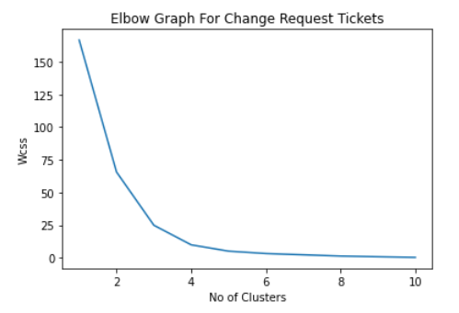
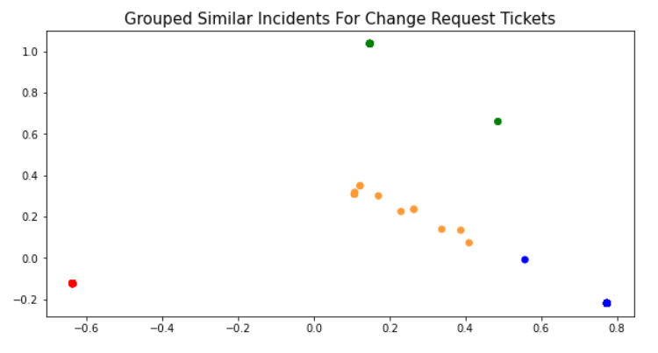
Clustering
Grouping the change request tickets to get its incident types with K-Mean clustering algorithms and chosen number of clusters 4 using Elbow plot.
Cloud Maintenance Incident Network Incident Capacity Incident User Service Request Incident
Notes:
All the change request related records can be grouped into different categories based on similarity of issue; they are related to.
But we do not know , how any groups can be created and what are they
For this processing unsupervised learning method : clustering is used.
To know how many groups are present in data, we use Elbow Graph method.
From left graph, it shows that there are 4 groups of records can be done.
For clustering k-means algorithm is used.
For k-means algorithm, all text records are converted to count of token vectors using countvectorizer library.
Based on contents of each groups , they are given with following names
Cloud Maintenance Incident
Network Incident
Capacity Incident
User Service Request Incident

Slide 10
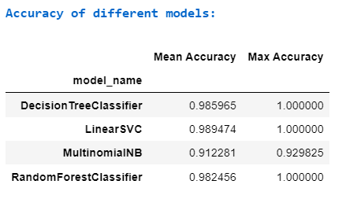
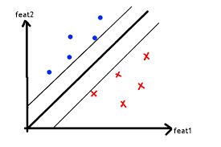
Models Result
Built set of 4 classification models with 5-fold cross validation and fitted on train data.
Finalised the LinearSVC model with 98% accuracy and saved the model using pickle.
Linear Support Vector Classifier
Notes:
When a new ticket related to change request is identified, then next task is to predict its incident type.
For this purpose, we will use machine learning model, which is trained on historical data.
For selecting the best classification model , we examined different algorithms :
LinearSVC Classifier
DecisionTreeClassifier
RandomForestClassifier
KNeighborsClassifier
MultinomialNB
All these models are trained and tested for 5-fold cross validation. There mean accuracy is used for selecting the best model.
From the statics shown in ppt, LinearSVC is having good Mean Accuracy , so we selected LinearSVC model for predicting the incidents related to change request.
For a trained model, when used for prediction, description of ticket & its impact will be input and any one of the following classes will be output.
1. Cloud Maintenance Incident
2. Network Incident
3. Capacity Incident
4. User Service Request Incident

Slide 11
Is Environmental Change?
Collected set of keywords related to environment change and identified incident tickets by passing set of keywords on description column.
Vectorizing the environmental change tickets by providing vocabulary which consists of Environmental change related keywords.
Notes:
This step is used to identify , if the record is related to a environmental change or not.
This step is required to find its incident type
A set of keywords (related to environmental change) is created.
A record having these keywords is considered as it is related to change request.

Slide 12
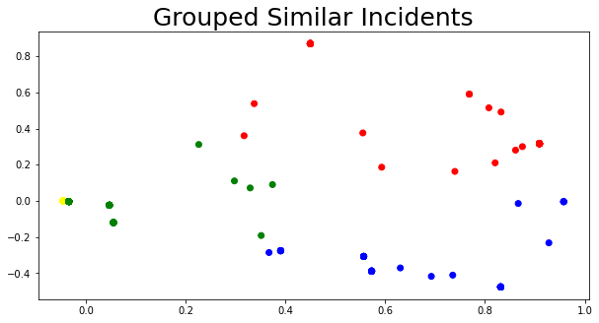
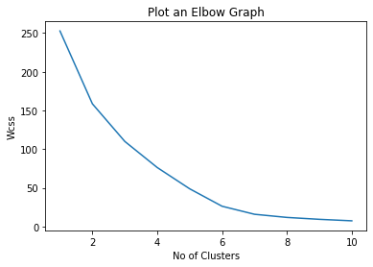
Clustering
Grouping the environment change tickets to get its incident types with K-Mean clustering algorithms and chosen number of clusters 4 using Elbow plot.
Capacity Incident
DB Incident
DBA Incident
SQL Maintenance Incident
Notes:
All the environmental change related records need to grouped in different categories. This is required for identifying the incident types
But these categories are not present data set, hence we used unsupervised learning methods
Elbow graph method is used find how many numbers of groups present in data
Kmens clustering to create the cluster/ groups of similar records
Based on contents of each groups , they are given with following names
Capacity Incident
DB Incident
DBA Incident
SQL Maintenance Incident

Slide 13
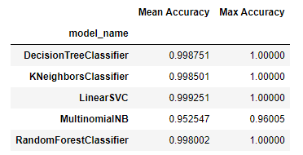
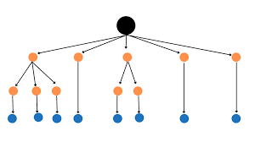
Models Result
Built set of 5 classification models with 5-fold cross validation and fitted on train data.
Finalized the DecisionTreeClassifier model with 99% accuracy and saved the model using pickle
Decision Tree Classifier
Notes:
From previous analysis, we have identified that an environmental change related record can be further classified into any one of 4 incident types.
For this purpose , we used machine learning model trained on previous records.
For selecting the best classification model , we examined different algorithms :
DecisionTreeClassifier
KNeighborsClassifier
LinearSVC Classifier
MultinomialNB
RandomForestClassifier
All these models are trained and tested for 5-fold cross validation. There mean accuracy is used for selecting the best model.
From the statics shown in ppt, DecisionTreeClassifier is having good Mean Accuracy , so we selected DecisionTreeClassifier model for predicting the incidents related to Environment change.
For a trained model, when used for prediction, description of ticket will be input and any one of the following classes will be output.
Capacity Incident
DB Incident
DBA Incident
SQL Maintenance Incident

Slide 14
Predictions Results
Notes:
For analysis , We have used 28,000 records , which are classified into different incident types by the models.

Slide 15
Development in Progress
Impact of Environment change
Predict change request failure
Predict the resolution time
Notes:
Once we have noticed that the new record is related to environmental change, the predict its incident type using the model , then predict the which services , applications will be impacted.
When you raise for a change request , then predict what probable incidents that can occur, what can be possible failure
We calculated average resolution time for all incidents. But in all incidents in one category can not have same resolution time , some will have more time, some will have less, So we are now working finding the relationship between the expected resolution time, its incident type & description.

Slide 16
PREDICTIVE Incident MANAGEMENT
BENEFITS
Key Benefits for Customer :
Improved Uptime & performance of Applications
Increased reliability of services
Improved Customer satisfaction and experience
Key Benefits for Business :
Saved man-hours on IT operations, resulting in reduced IT operations costs
An increase in the efficiency and productivity of IT personnel
Resolving IT problems faster
A more predictable IT environment

Slide 18
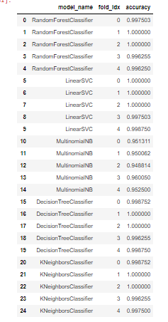
Cross Validation

Slide 19
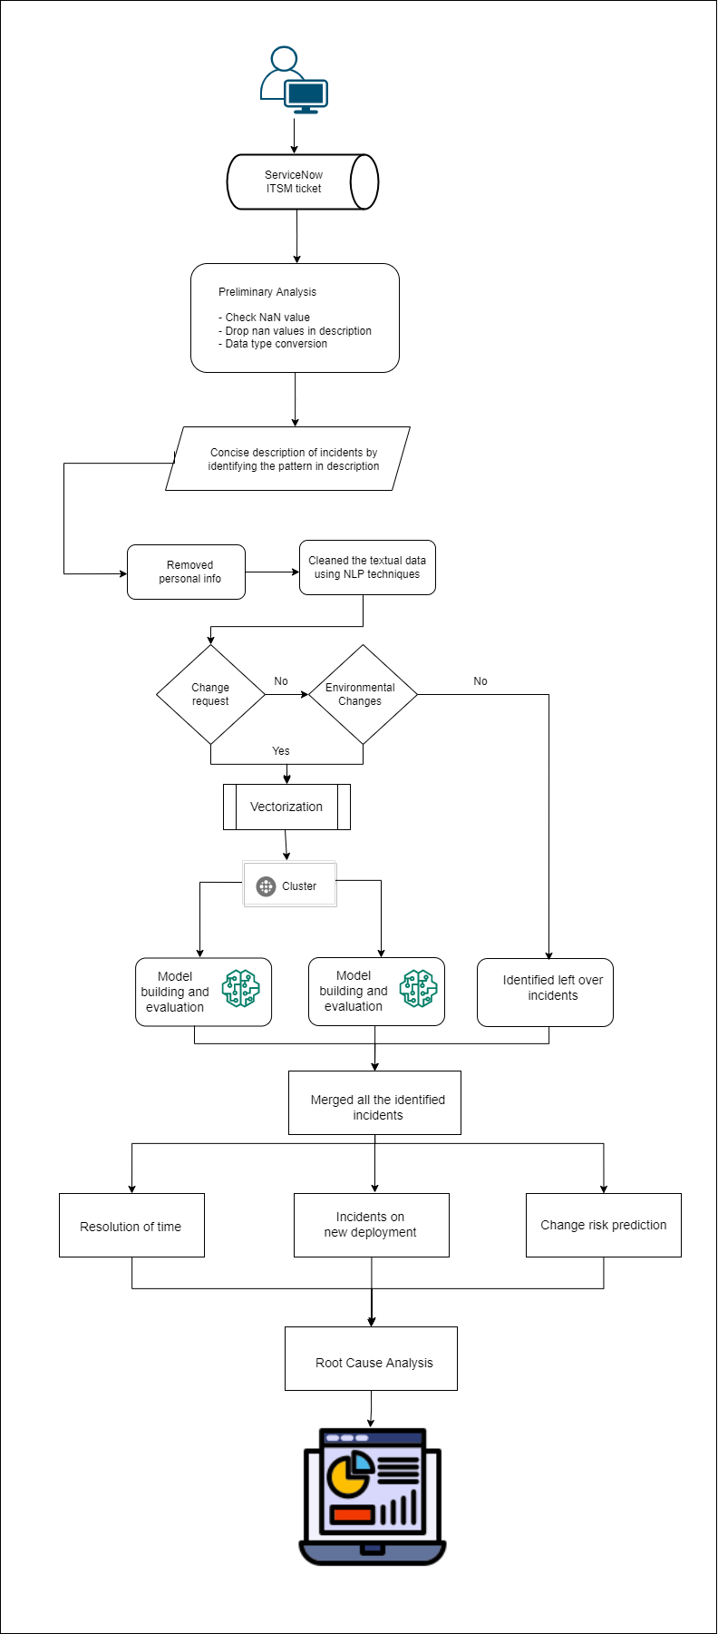

Slide 20
Env_Change_Keywords= ["sql","server","integration","load balance","notification","db","database","webserver","website","share","connectivity"]
Change_keyword=["update","change","enhancement","release","deployment","implement","permission"]

